Slide 1
Road sign recognition system
Group 8: string the_boys;
NAME
ROLL NO
PRUTHVIRAJ DODIYA
AU2040175
HARSHRAJSINH VAGHROLA
AU2040195
MANAN VADALIYA
AU2040264
MOHSINALI VIJAPURA
AU2040080

Slide 2
I
Introduction
In this project, using the power of deep learning and computer vision techniques to develop an image classification system that can accurately recognize and classify different types of traffic signs.
It can be utilised to improve the safety of autonomous vehicles and driver support systems. It can also be used by traffic authorities to examine and track traffic patterns, spot congested locations, and enhance traffic management.
I
Problem statement
The project aims to create a system that can use a webcam to identify different traffic signs in real-time using a convolutional neural network. The system should be accurate, efficient, and able to different traffic signs. This will improve road safety by helping drivers recognize and understand traffic signs they may have missed or misunderstood.

Slide 3

I
Existing body of work
Road signal recognition can be performed using various algorithms Convolutional Neural Networks (CNN), Support Vector Machines (SVM), Decision Trees, Random Forest, Hough Transform and etc. We can achieve accuracy of around 90% when the network is trained using the Tensorflow and Keras libraries. Which focuses on developing a classification system in which we create different classes based on the differentiating factor to solve the problem of traffic sign recognition, and when it is combined with pre-processing and localisation phases it produces excellent results.

Slide 4
I
Approach
Load and spliting dataset : Load the images from the directory using OpenCV ,split the dataset into training, validation, and testing sets using the train_test_split function from scikit-learn.
Preprocess the images by converting them to grayscale, by normalizing them between 0 and 1, and equalizing the histogram to improve the contrast of the images.
Build the CNN model: Create a Sequential model in Keras and add convolutional, max pooling, and dense layers to the model. The convolutional layers learn to extract features from the input images, while the dense layers classify the features into the different classes.
Compile and train model: Train the model using fit function in Keras with specified batch size, number of epochs and steps per epoch. Use validation set to monitor model performance during training and avoid overfitting.
We will then evaluate and save our model and use it for further predicitons
5

Slide 5
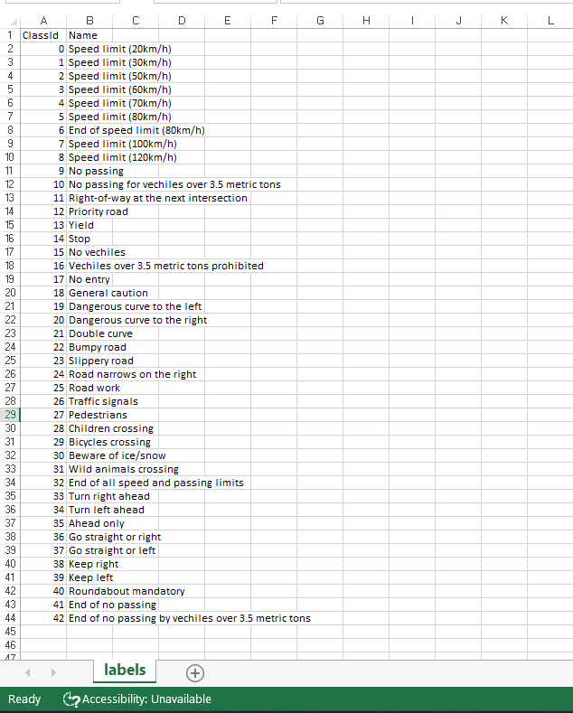
I
DATASET
We have taken the dataset from kaggle and
in this project we will train traffic signs with over 35000 images of 43 different classes with the help of tensorflow and keras .
5

Slide 6
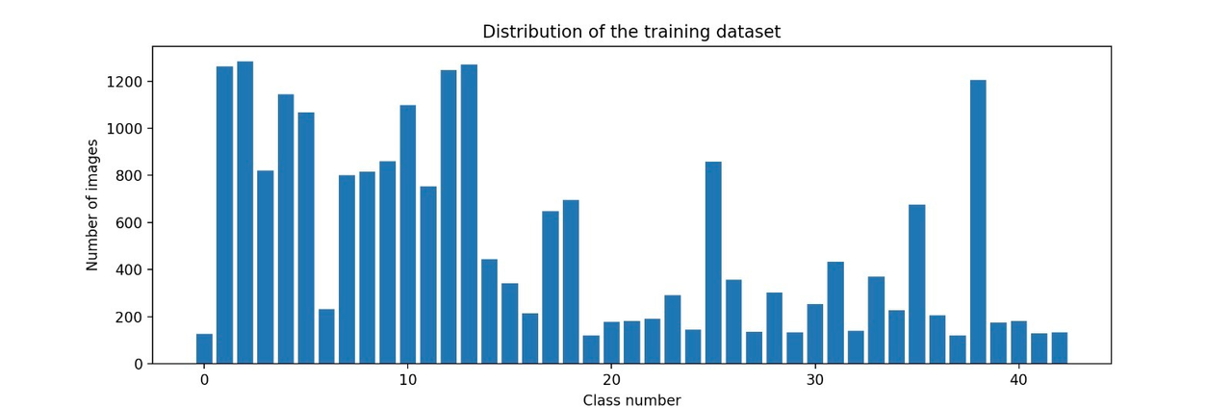
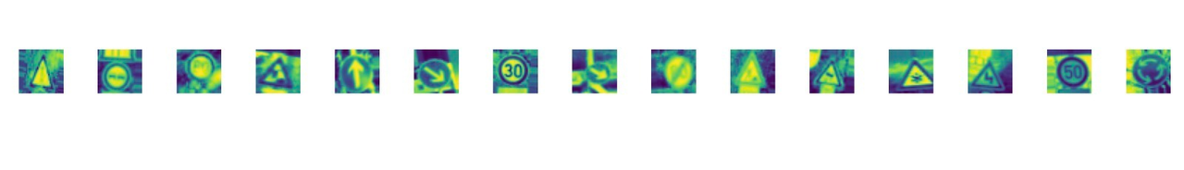

I
Initial results
The first picture describes the frequency distribution of each class(i.e type of road sign) from the dataset.
The second and third pictures denotes the preprocessing of the dataset images by converting them to :
Grayscale
Standardizing the lighting in image
Normalizing the image from 0 to 1 instead of 0 to 255
Hypothesis 1
6

Slide 7

I
Role of members & Future work
Manan: Understanding the dataset and designing code for the preprocessing of the images.
Pruthviraj: Understanding different algorithms necessary for the further step and data cleaning.
Harshraj: Analyzing the data, report writing and designing presentation, running the accuracy tests on output .
Mohsin: Designing of the codes and implementation of algorithms over the dataset, content and designing of reports and presentations.
Future work:
Feature Extraction: This step involves identifying key features of traffic signs, such as shape, color, and texture.
Classification: Once the traffic signs have been detected, they need to be classified into their respective categories. This step involves using a machine learning algorithm to identify the type of traffic sign, such as stop sign, yield sign, or speed limit sign.
7

Slide 8
I
References
A. KAPOOR, N. NEHRA, AND D. DESHWAL, “TRAFFIC SIGNS RECOGNITION USING CNN,” IN 2021 INTERNATIONAL CONFERENCE ON INDUSTRIAL ELECTRONICS RESEARCH AND APPLICATIONS (ICIERA), 2021, PP. 1–4.
N. Veličković, Z. Stojković, G. Dimić, J. Vasiljević, and D. Nagamalai, “Traffic sign classification using Convolutional Neural Network.” .
S. Reddy, D. Dash, and N. Rakesh “Image Classification Using Machine Learning Techniques for Traffic Signal”. In Intelligent Data Communication Technologies and Internet of Things (pp. 233-244), Springer, Singapore 2021.
Luo, H., Yang, Y., Tong, B., Wu, F., & Fan, B. (2017). Traffic sign recognition using a multi-task convolutional neural network. IEEE Transactions on Intelligent Transportation Systems, 19(4), 1100-1111.
Shustanov, A., & Yakimov, P. (2017). CNN design for real-time traffic sign recognition. Procedia engineering, 201, 718-725.
ZHU, Y., ZHANG, C., ZHOU, D., WANG, X., BAI, X., & LIU, W. (2016). TRAFFIC SIGN DETECTION AND RECOGNITION USING FULLY CONVOLUTIONAL NETWORK GUIDED PROPOSALS. NEUROCOMPUTING, 214, 758-766.

